Slide 1



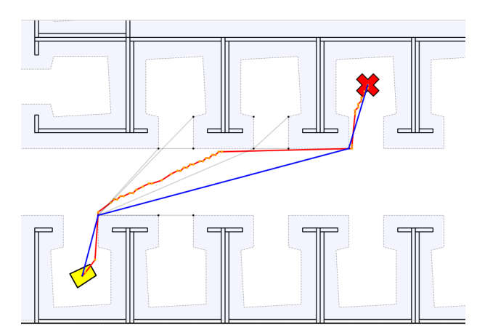
Reducing Onboard Processing Time for Path Planning in Dynamic Environments
Presentation by Group 10
Aman Singh
Aditya Shirwatkar
Jana Ravi Kiran
TA and Mentor
Ajay Kumar Sandula
Reference: M. Missura, D. D. Lee and M. Bennewitz, "Minimal Construct: Efficient Shortest Path Finding for Mobile Robots in Polygonal Maps," 2018 IEEE/RSJ International Conference on Intelligent Robots and Systems (IROS), Madrid, Spain, 2018, pp. 7918-7923, doi: 10.1109/IROS.2018.8594124.

Slide 2
Agenda
Motivation
Introduction
Literature Overview
Implementation
Results and Discussion
Scope of Future Work
Agenda

Slide 3
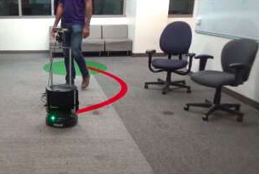
Motivation
Autonomous agents face the challenge of coordinating multiple tasks (perception, motion planning, controller) on a single onboard computer
All these tasks are computationally expensive
This work focuses on reducing onboard processing time for global path planning in polygonal maps.
Image Source: https://techxplore.com/news/2020-04-framework-indoor-robot-humans.html
Motivation

Slide 4
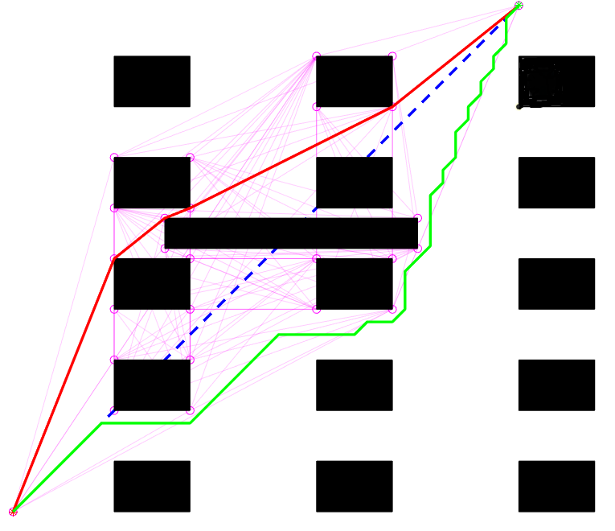
Introduction
Traditional way of finding the shortest path
Grid based maps (blocked, free or unknown)
Search using A* or Djikstra's algorithms
Advantages of polygonal maps
Less time complexity
Less memory foot-print
Well suited to represent moving obstacles
Not prone to pitfalls of discretization
Introduction

Slide 5
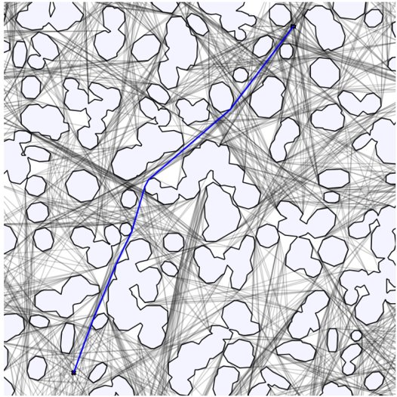
Literature Review
Construction Visibility Graph
More time consuming than search
Not suitable for changing environments (repair or reconstruction)
Time Complexity
Upper Bound - O(n²)
Lower Bound - Ω(n²)
Reference: M. Missura, D. D. Lee and M. Bennewitz, "Minimal Construct: Efficient Shortest Path Finding for Mobile Robots in Polygonal Maps," 2018 IEEE/RSJ International Conference on Intelligent Robots and Systems (IROS), Madrid, Spain, 2018, pp. 7918-7923, doi: 10.1109/IROS.2018.8594124.
Literature Review

Slide 6
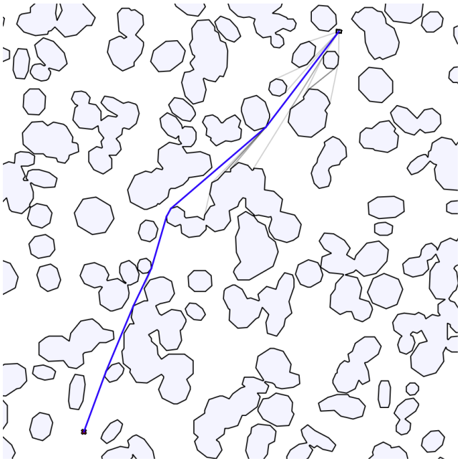
Literature Review: Minimal Construct Algorithm
Construction Visibility Graph
Compute only necessary portion during A* search
Graph edges are only checked for intersection with polygons when they are popped from the priority queue
Exploiting the fact that concave corners and non-tangential edges can never be a part of shortest path
Time Complexity
Upper Bound - O(n²)
Lower Bound - Ω(n)
Reference: M. Missura, D. D. Lee and M. Bennewitz, "Minimal Construct: Efficient Shortest Path Finding for Mobile Robots in Polygonal Maps," 2018 IEEE/RSJ International Conference on Intelligent Robots and Systems (IROS), Madrid, Spain, 2018, pp. 7918-7923, doi: 10.1109/IROS.2018.8594124.
Literature Review

Slide 7
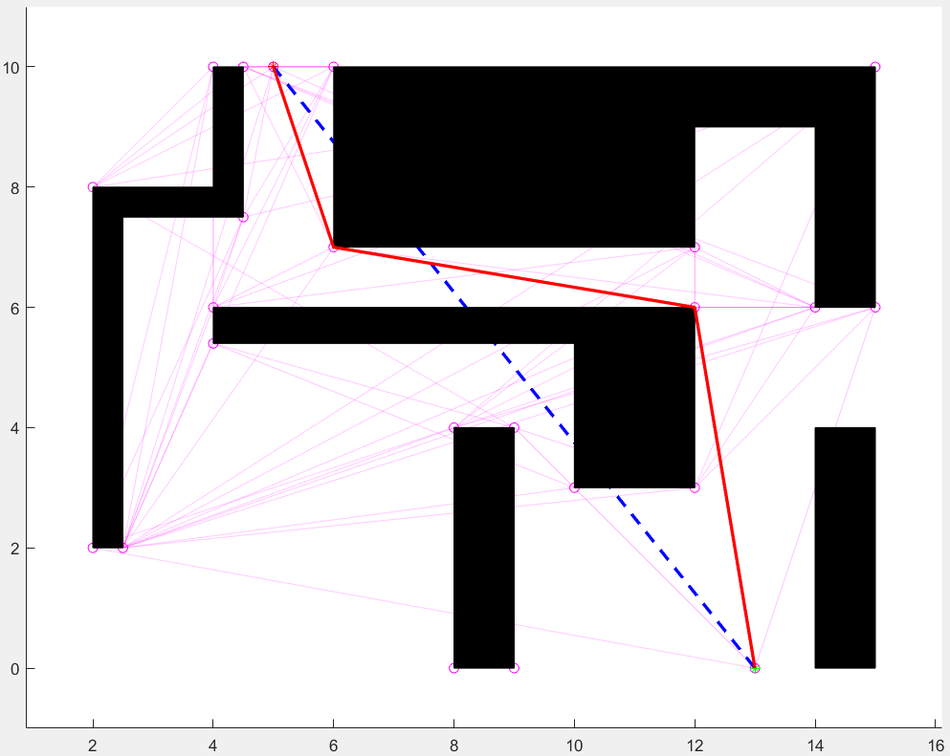
Implementation
Used MATLAB Robotics Toolbox
Global Path planning:
Used Minimal Construct Algorithm to give shortest global path
Compared its computation time against the Grid based A* algorithm
Control:
Used pure pursuit controller to follow the global paths
Code:
https://github.com/aditya-shirwatkar/CP230_HWS
Implementation

Slide 8
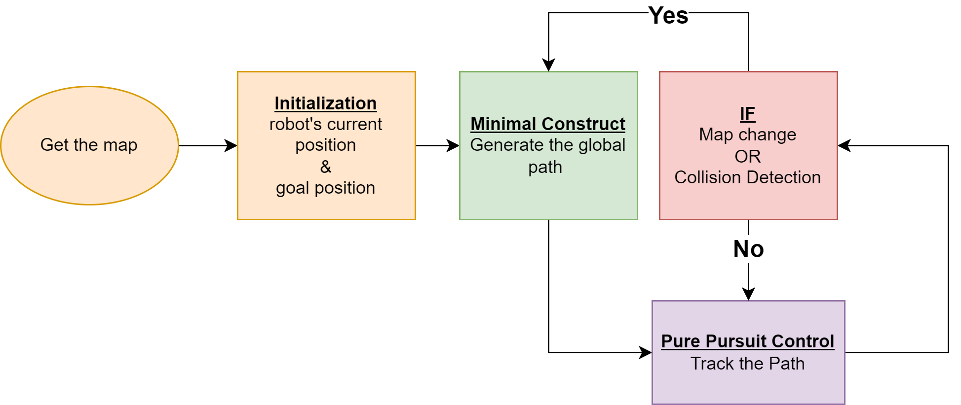
Implementation: Flowchart
Implementation

Slide 9
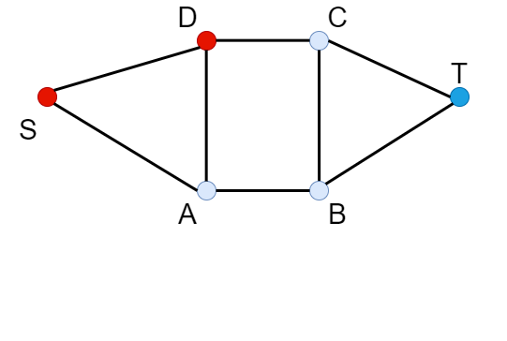
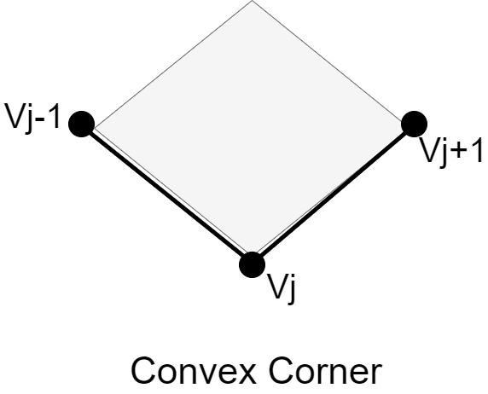
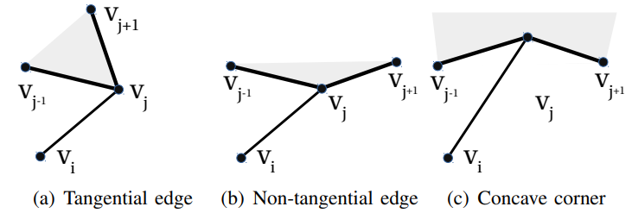
Minimal Construct Algorithm: Preliminaries
Neighborhood: All the nodes connected through an edge
Closed node: If algo reaches a node we call it closed node
Parent: The closest, closed node in the neighborhood
Convex vertices of Polygon: All the vertices which form an external angle greater than 180°
Tangential point: Point V_{j} is tangential w.r.t V_{i} if, V_{j}+1 and V_{j}-1 are on the same side of the line V_{i}-V_{j}
Reference: M. Missura, D. D. Lee and M. Bennewitz, "Minimal Construct: Efficient Shortest Path Finding for Mobile Robots in Polygonal Maps," 2018 IEEE/RSJ International Conference on Intelligent Robots and Systems (IROS), Madrid, Spain, 2018, pp. 7918-7923, doi: 10.1109/IROS.2018.8594124.
Implementation

Slide 10
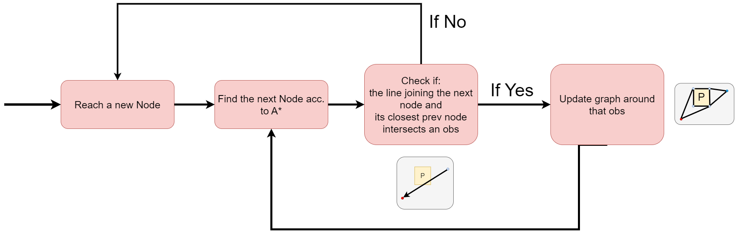
Minimal Construct Algorithm: Overview
Implementation

Slide 11
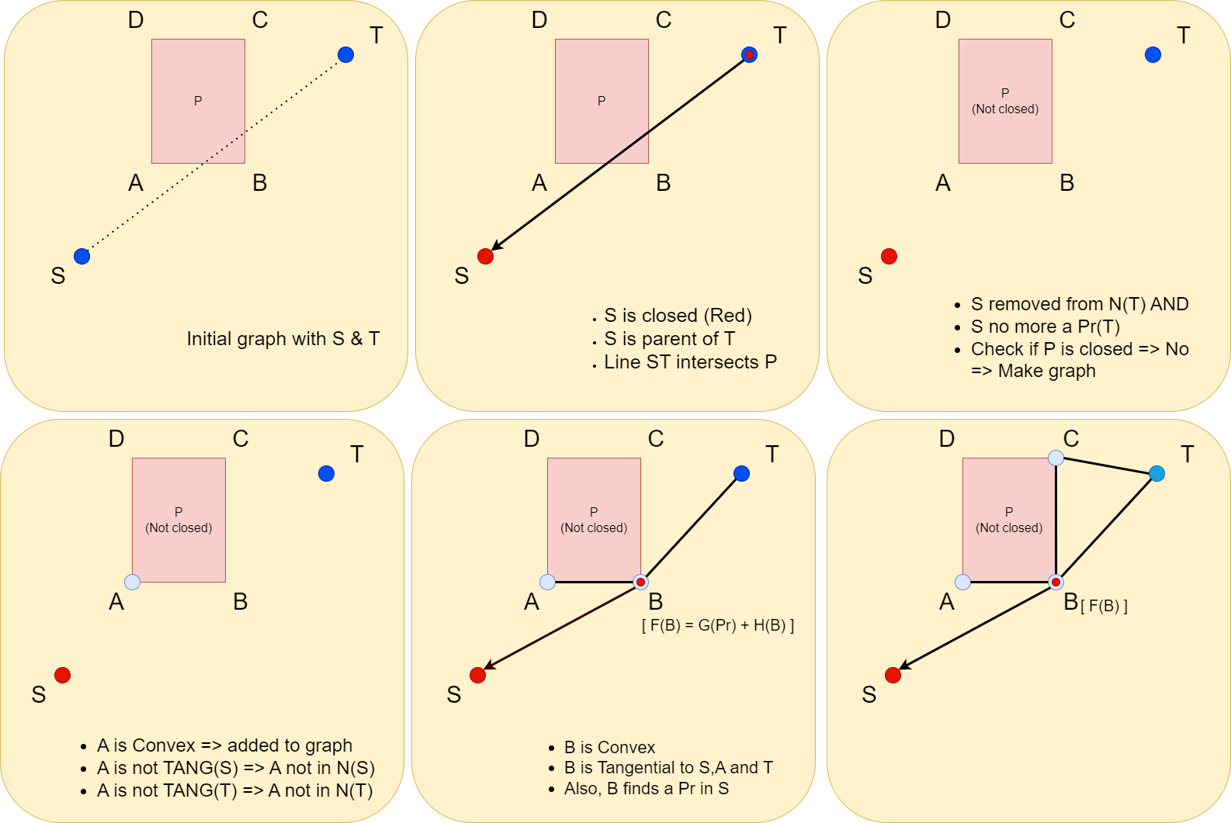
Minimal Construct Algorithm: Example
Implementation

Slide 12
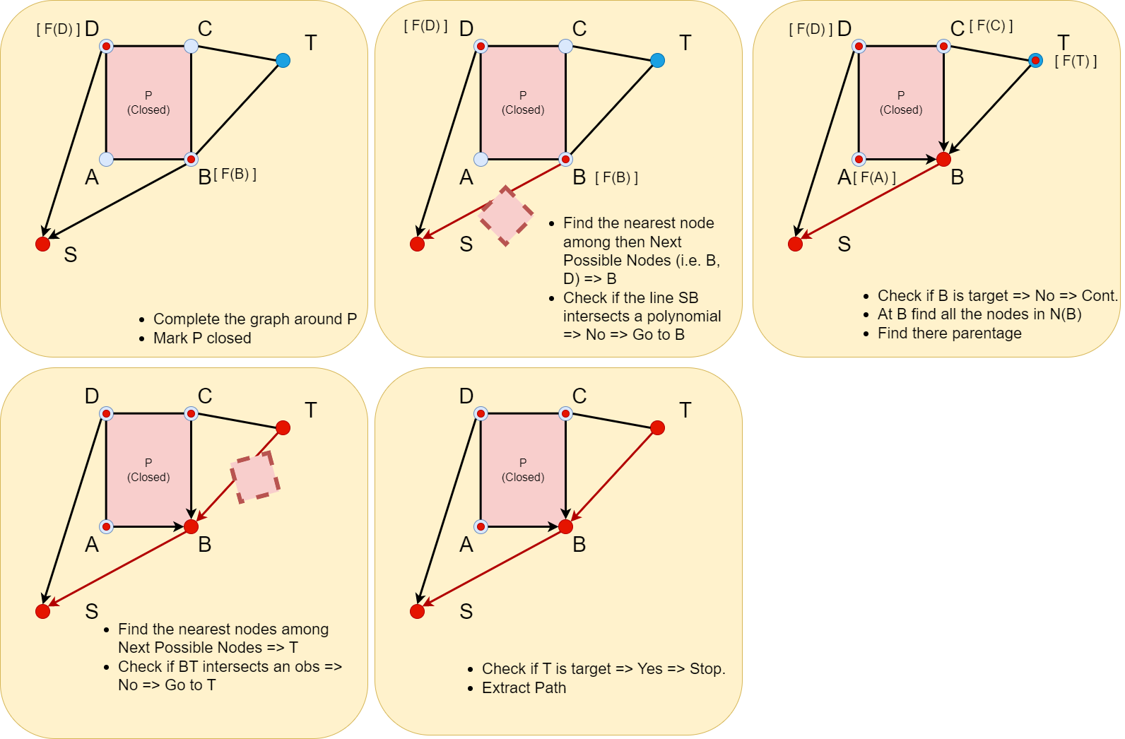
Minimal Construct Algorithm: Example
Implementation

Slide 13
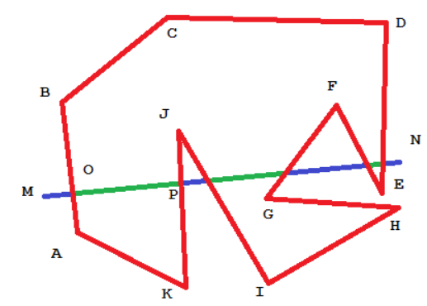
Minimal Construct Algorithm: Line Intersection Test
Divide the line segment into sub-line segments using intersection points with the polygon.
Check if any midpoint of the sub-line segments lies inside the polygon.
If yes, the line segment intersects the polygon. If not, it doesn't intersect the polygon.
Image Source: https://www.codeproject.com/Articles/371959/A-brute-force-approach-to-check-if-a-line-segment
Literature Review
Implementation

Slide 14
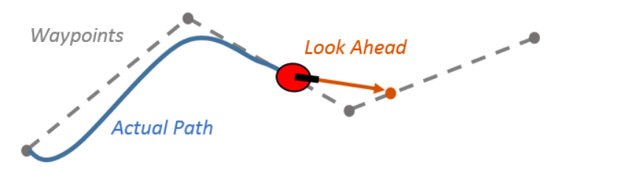
Pure Pursuit Controller
The controller calculates a lookahead point on the desired path and determines the steering angle required to guide the robot towards that point.
The steering angle is calculated based on the pursuit angle, which is the angle between the robot's heading and a line connecting the robot's position to the lookahead point.
Image Source: https://in.mathworks.com/help/nav/ug/pure-pursuit-controller.html
Implementation

Slide 15
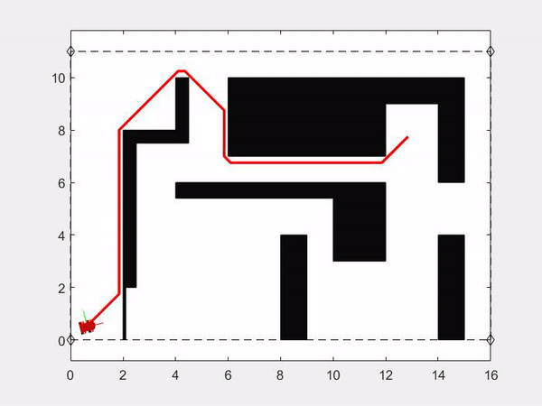
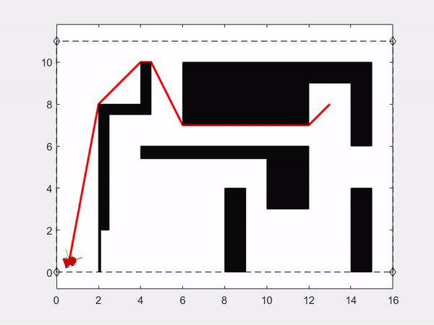
Dynamic Office Environment (Case 1):-
A* grid
Minimal Construct
Results

Slide 16
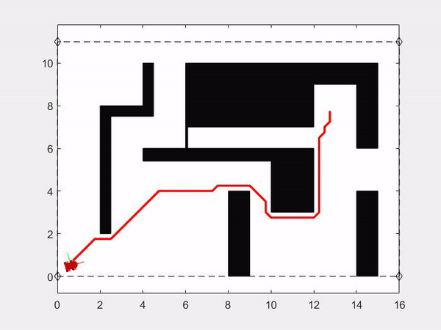

Dynamic Office Environment (Case 2):-
A* grid
Minimal Construct
Results

Slide 17
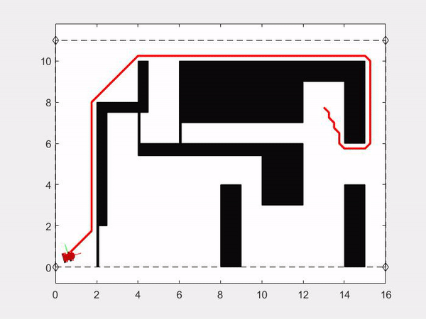
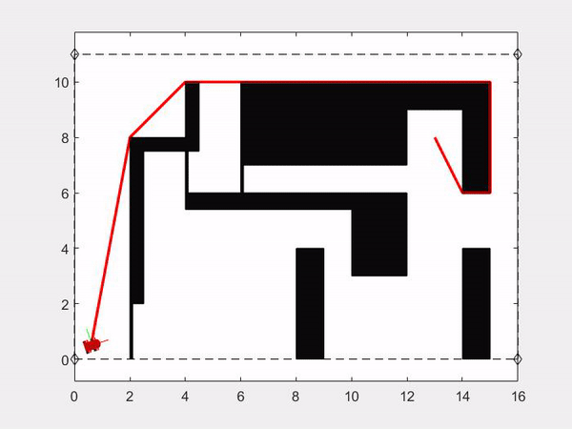
Dynamic Office Environment (Case 3):-
A* grid
Minimal Construct
Results

Slide 18
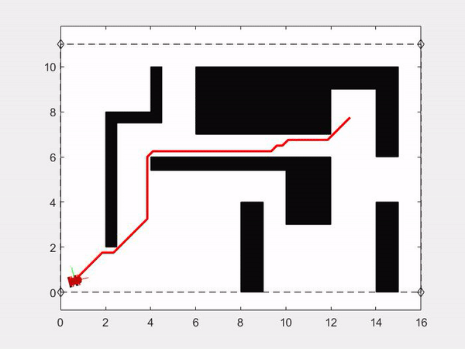
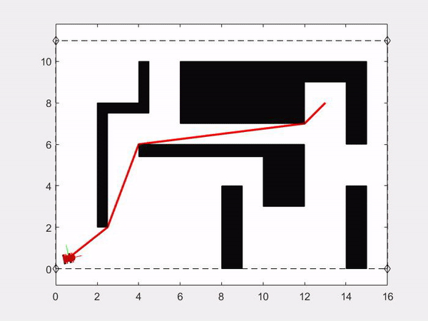
Dynamic Office Environment (Case 4):-
A* grid
Minimal Construct
Results

Slide 19
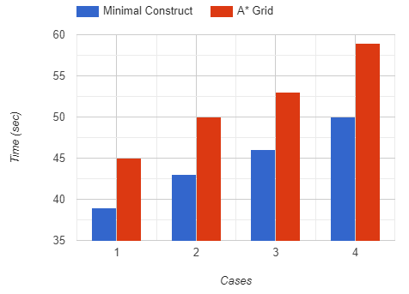
Comparison
Recomputed time (sec)​ | Minimal Construct | A* Grid
Case 1 | 0.72428 0.70226 | 2.862 2.4654
Case 2 | 0.72056 0.38755 | 3.4207 1.7273
Case 3 | 0.66066 0.37973 | 2.9466 1.9843
Case 4 | 0.59119 0.27378 | 2.8302 1.4022
Total Time taken to Reach Goal
Results

Slide 20
Scope for future work
Robust Local planner for obstacle avoidance
Code optimization in C++
Implementation to different real-world scenarios
Extension to 3D polytopes for UAVs, if possible
Future Work
Notes:
such as moving people and objects, opening and closing doors, or simply the exploration of an unknown part of the map,

Slide 21
Thank You!

Slide 22
Problems Faced
Line Intersection Test
Most computationally expensive function
Could not implement a generalized version
Generating a dynamically evolving map
Implementation

Slide 23
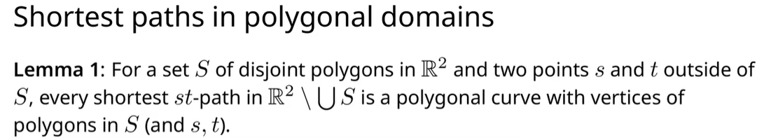
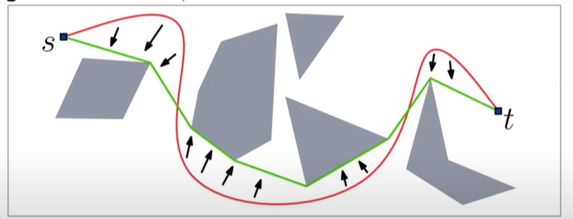
Visibility graph

